Slide 1
Mini-Project ATTENDANCE USING FACE RECOGNIZATION

Slide 2
Name of Students and PRN No: (Group No.06) Vaibhav Sontakke (2020BTEIT00074) Sejal Atram (2020BTEIT00067) Kanchan Korde (2020BTEIT00065) Priyanka Thombare (2020BTEIT00046) Under the Guidance of Prof. Dr. Umesh Chavan

Slide 3

AGENDA
Introduction
Problem Statement
Objective
Flowchart
Methodology
Technology Stack
References

Slide 4
INTRODUCTION
Attendance Management System using face reconition is a system developed for daily student attendance in college. Face recognition could be a trending technology used in many areas using security, automation and many more thinga. We are aiming and targeting on the attendance of the scholars by applying OpenCV and few other python libraries.

Slide 5
PROBLEM STATEMENT
Taking manual attendance by teacher daily in the classroom in is a time consuming task. Maintaning attendance is also a probalamatic task for teachers.
=>=--

Slide 6
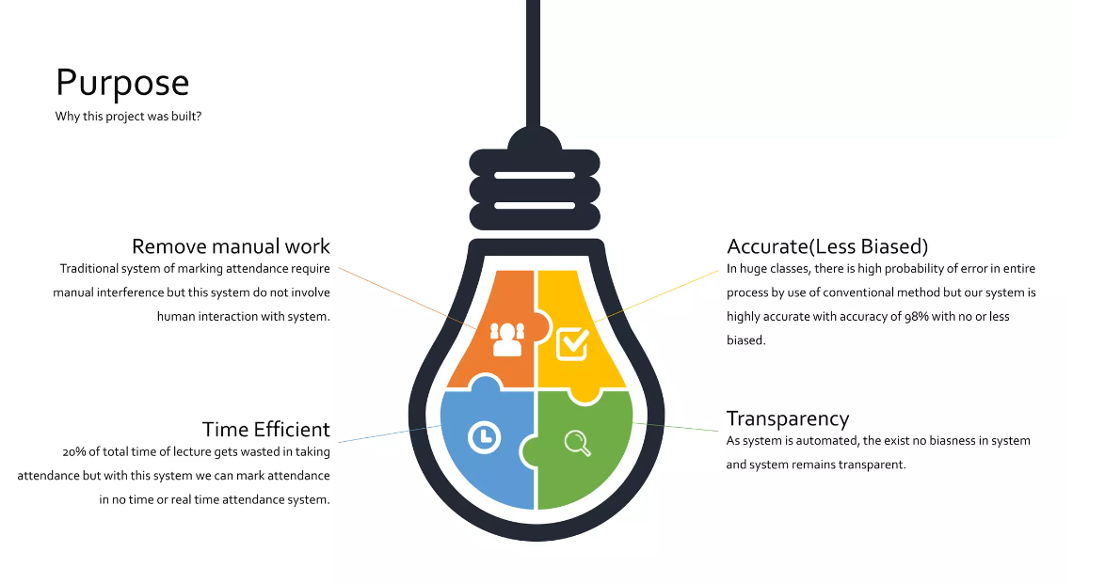
OBJECTIVE

Slide 7
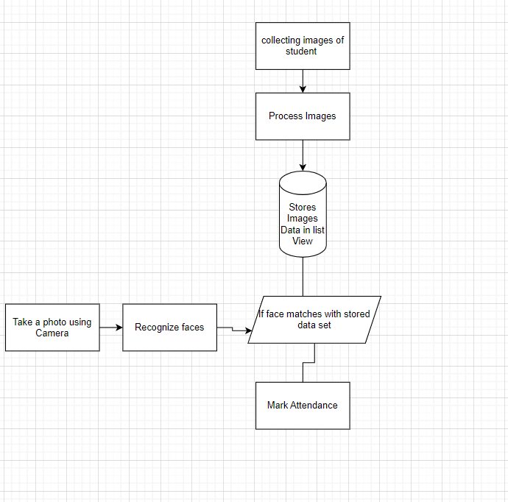
FLOWCHART

Slide 8
METHODOLOGY
Collecting data: first step is to collect the images of student.
Process the Images and store the incoded data of the images.
take the photo using camera
if a faces recognised in photo matches with the data data stored of images, then maek the attendance.

Slide 9
TECHNOLOGY STACK
Language : Python
Domain : Machine Learning
Database : My SQL
Libraries :
OpenCV : Image Processing
Face Recognition : For Face Recognition
Numpy

Slide 10
REFRENCES
Anuradha Srinivasaraghavan and Vincy Joseph(2019) Machine Learning, Willey India PVT. Ltd.
Deeplearning By Ian Goodfellow and Yoshua Bengio and Aaron Courville
An MIT Pressbook.

